Slide 1
SASS - introduction (Day 1)
Viktoras Lava www.viktoraslava.lt

Slide 2

What is SASS?
SASS stands for Syntactically awesome style sheets. It is powerful CSS language extension.
Most of the modern websites are writtien in SASS, as it let’s you to manager your styles in an easy way.

Slide 3

Why use SASS?
Without SASS it wouldn’t be possible (or very difficult) to create modern websites.
You should use SASS, because it makes easier to:
maintain your CSS
extend your website
collaborate with colleagues
reuse your CSS

Slide 4

How to install SASS?
In order to compile SASS into CSS you need a pre-processor.
There are few programs that can do that:
Prepros
CodeKit
Koala

Slide 5
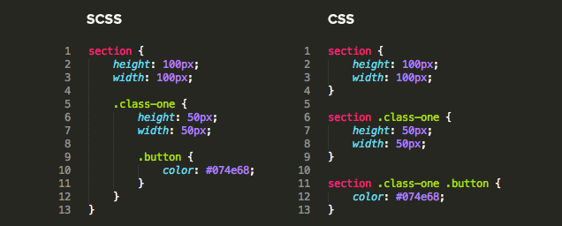
Differences between SASS and CSS

Slide 6
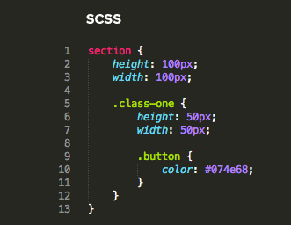
Nesting
We will talk about basic SASS features in detail:
Nesting
Variables
Import
Partials
These are very important to learn.

Slide 7
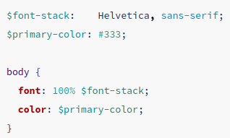
2. Variables
Variable let’s you to store information that you want to reuse.
You can store colors, fonts or CSS values you need.
Storing is done with $ symbol.

Slide 8
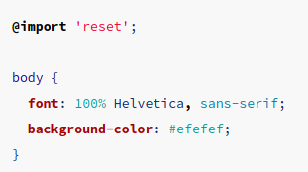
3. Import
Import rule let’s you to import SASS or CSS files into other SASS files.
Notice that you don’t need to specify the file extension:
@import ‘reset.scss’
it’s enough to write @import ‘reset’;

Slide 9
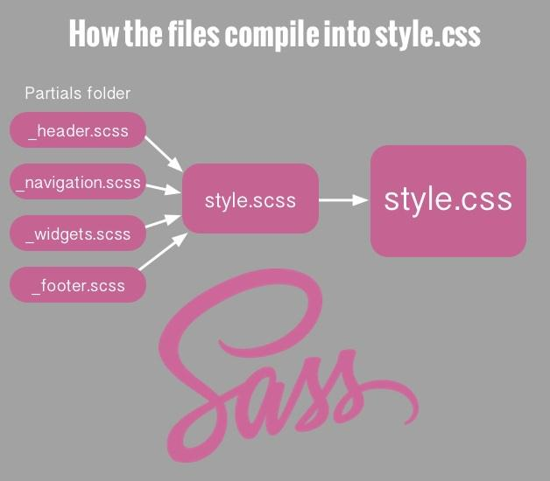
4. Partials
Partials are SASS files that are meant to be included into other SASS files.
You can create a partial SASS file by naming the file with an underscore, for ex. “_reset.scss”.
Then you can import this partial with the import rule. For ex.
@import “_reset”

Slide 10
Questions?

Slide 11
References:
Prepros guide - https://prepros.io/help
SASS guide - https://sass-lang.com/guide
SASS + Prepros video guide - https://youtu.be/j_tdnuh2tDU

